Slide 2
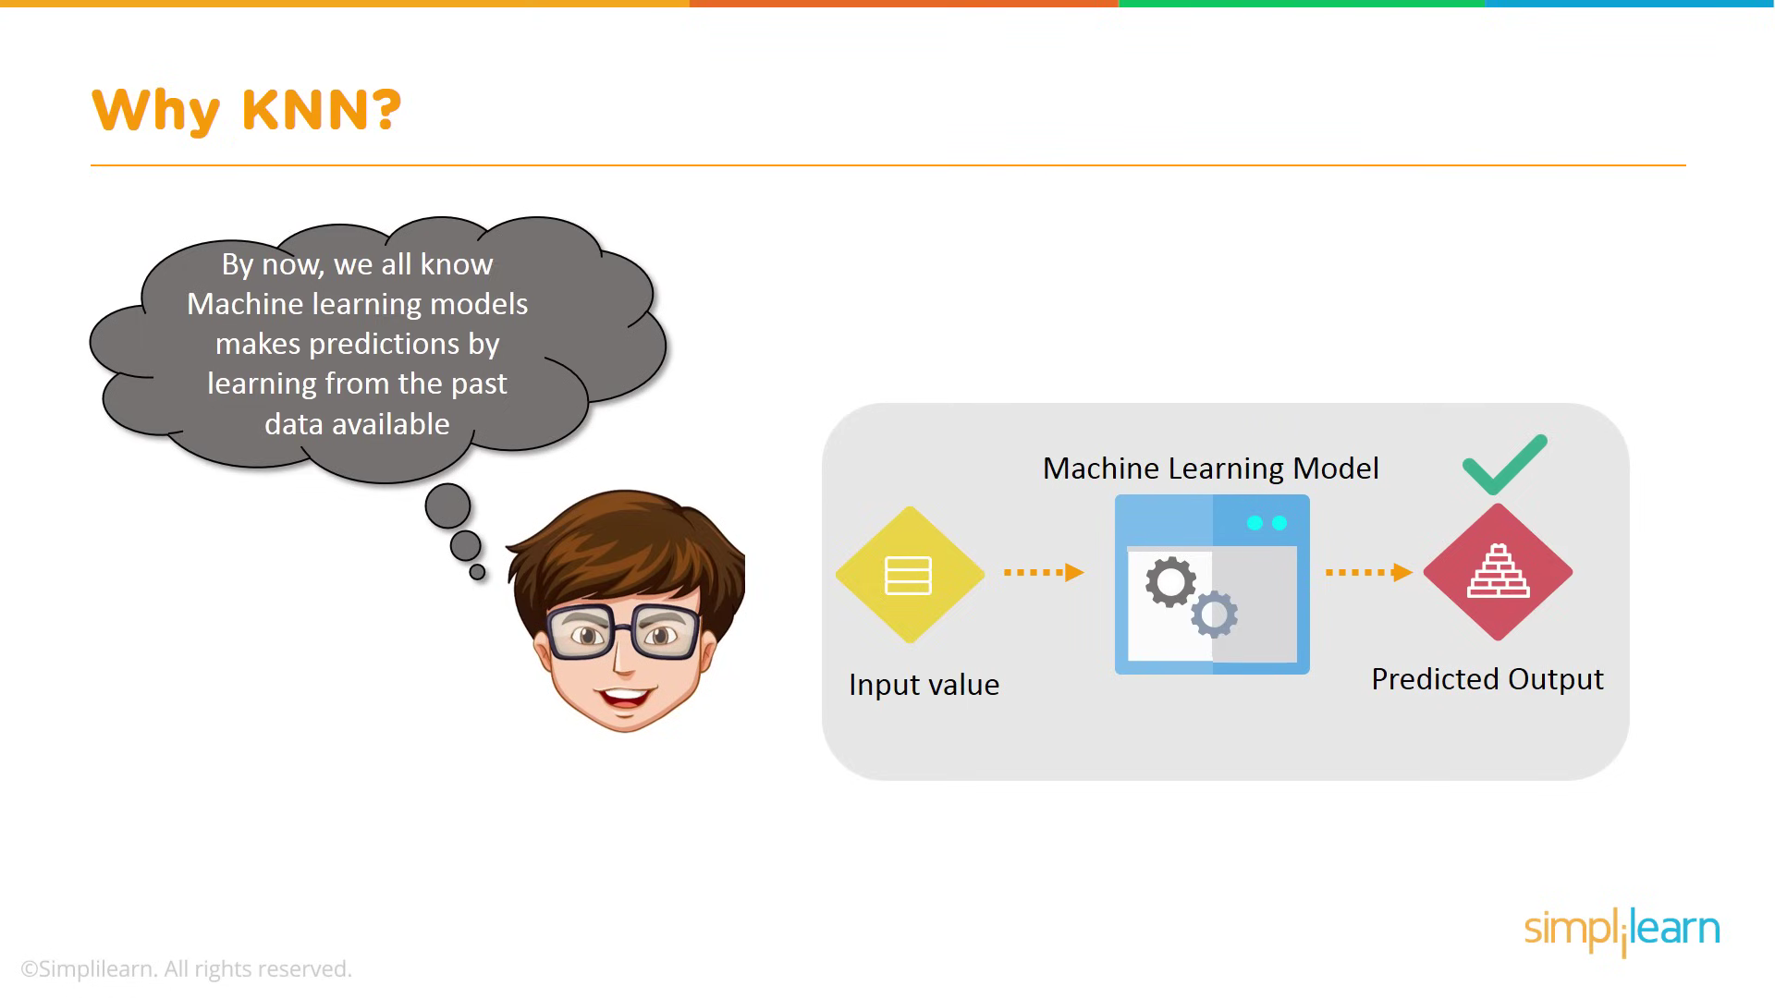

Slide 3
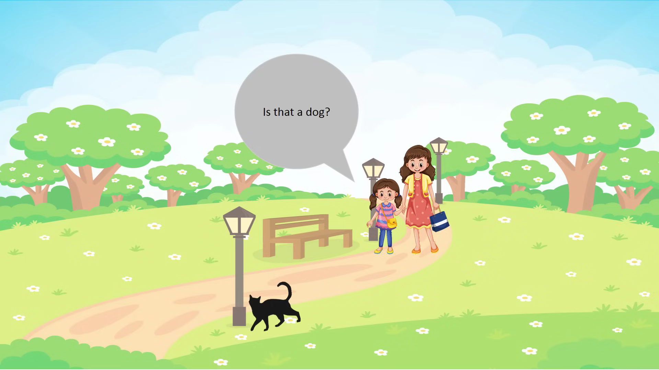

Slide 4
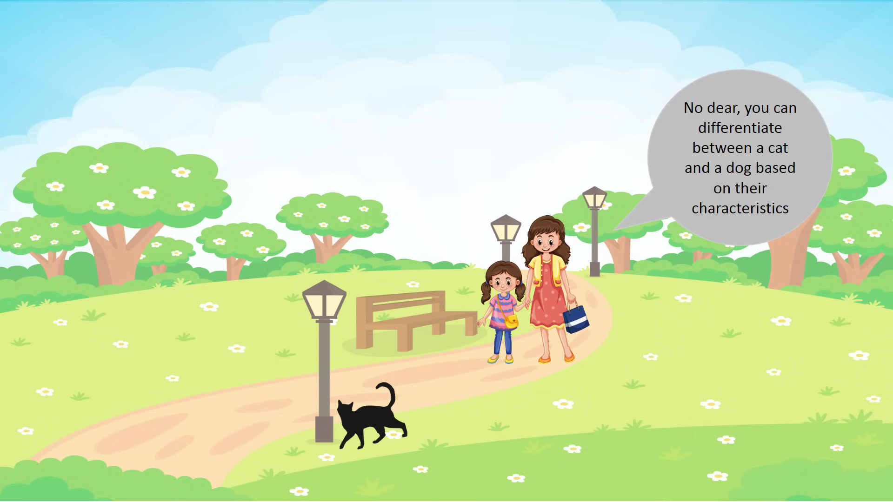

Slide 5
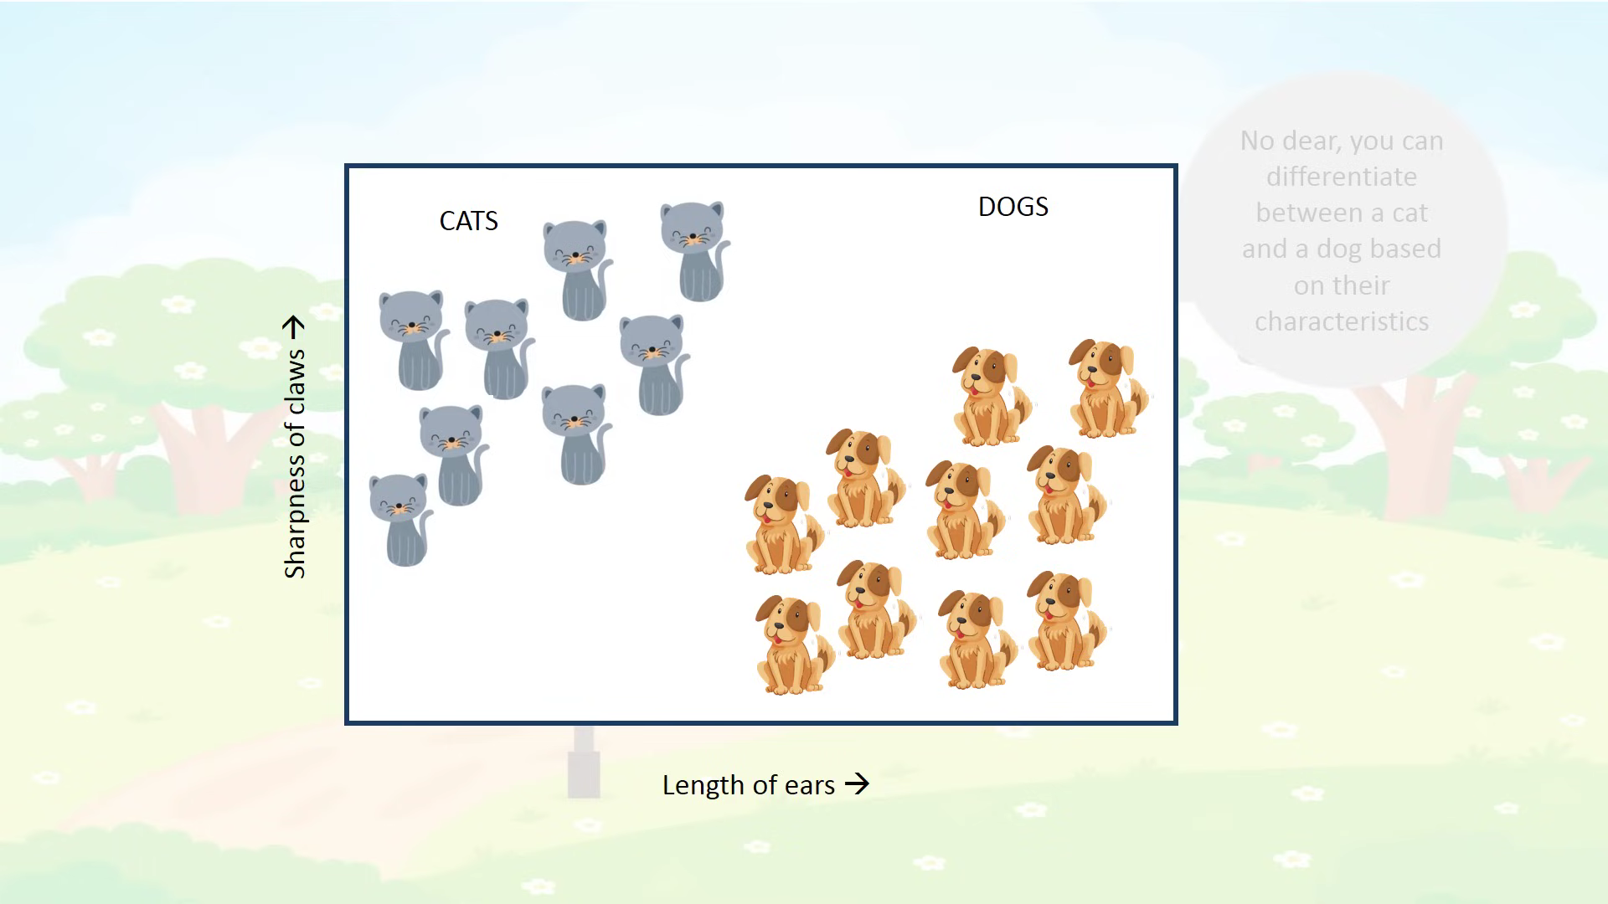

Slide 6
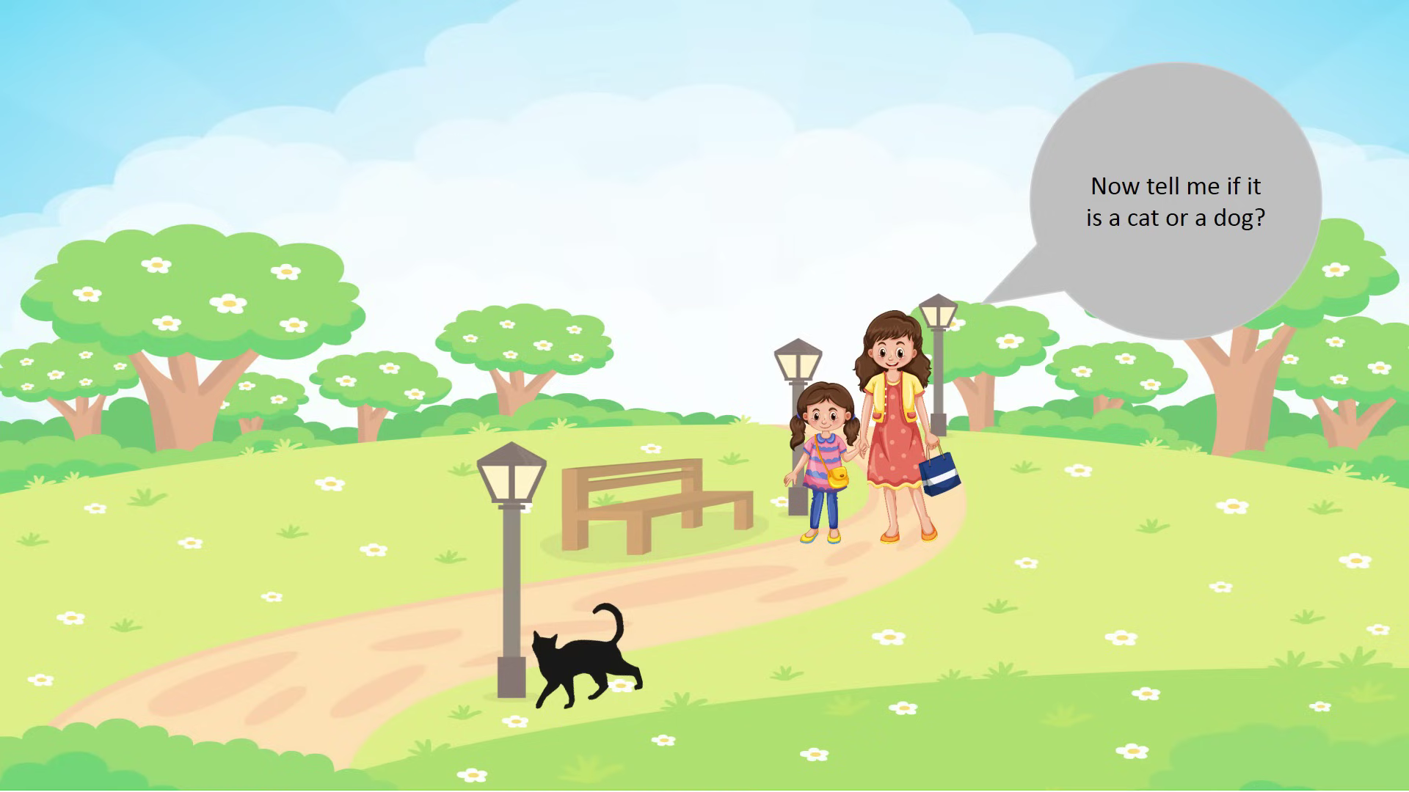

Slide 7
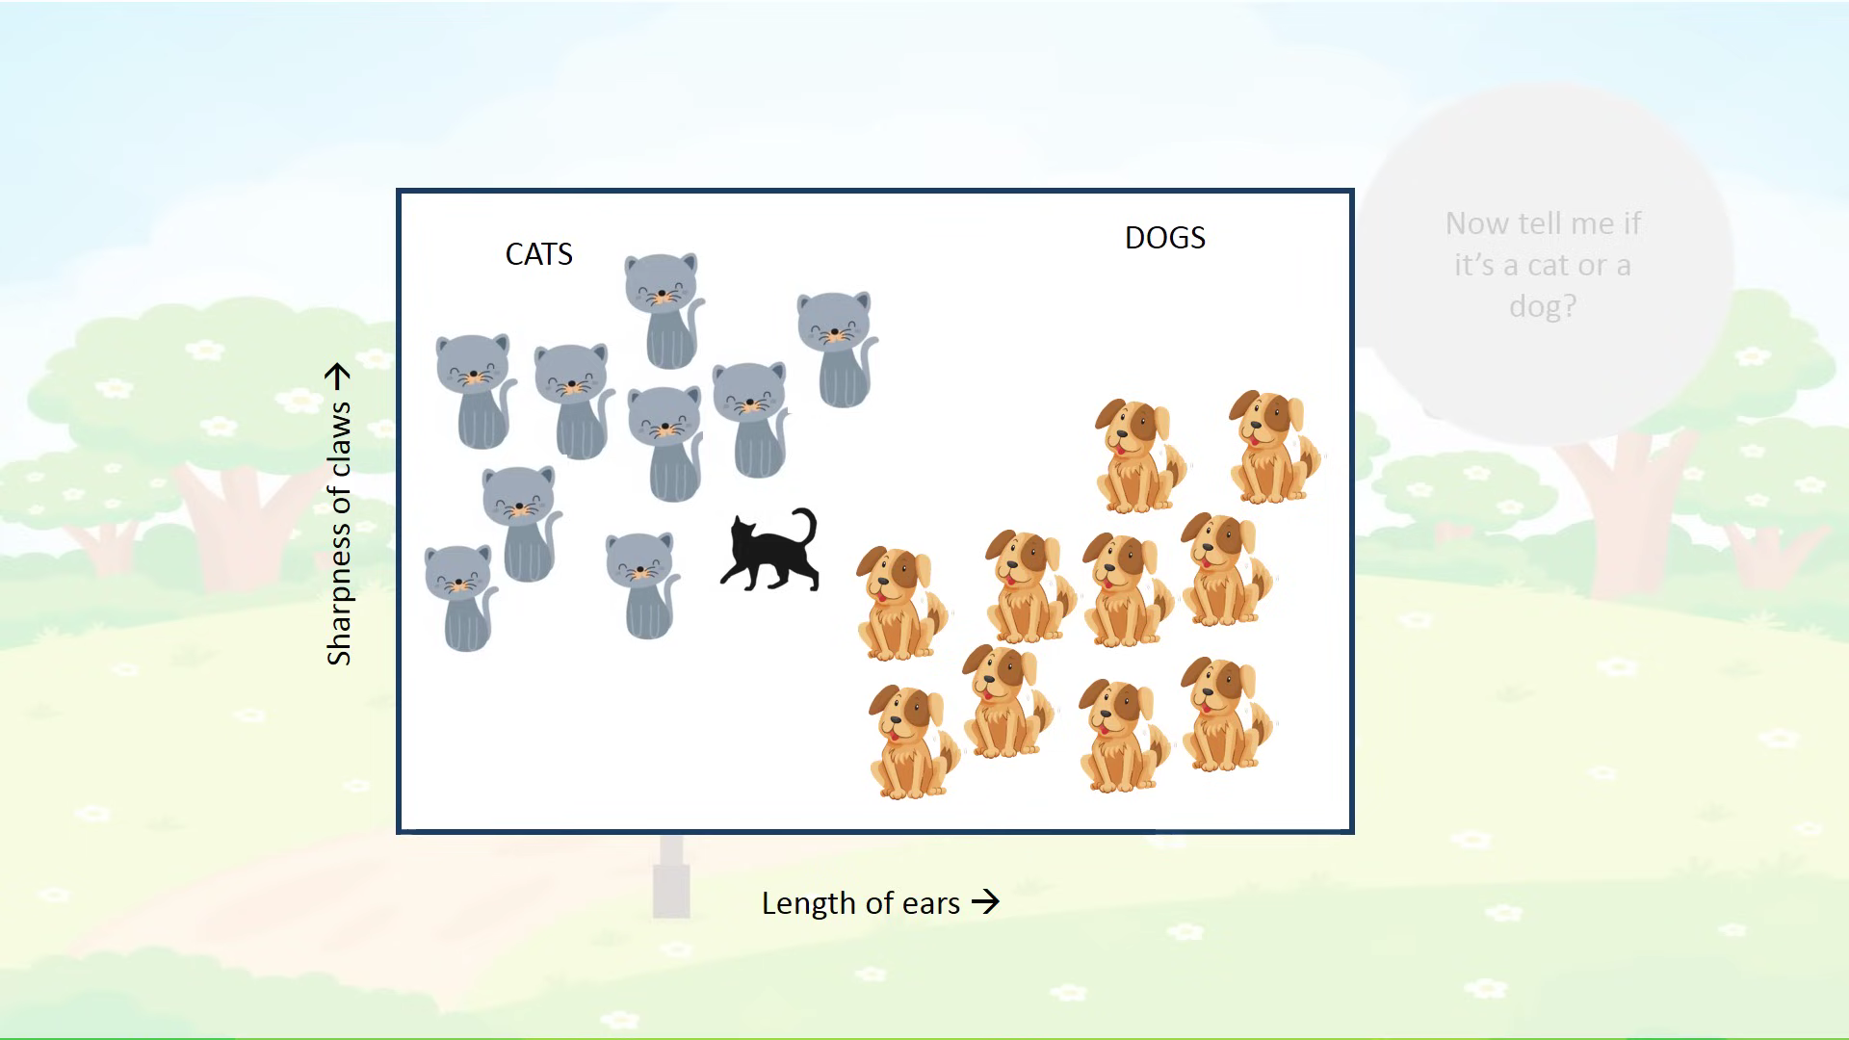

Slide 8
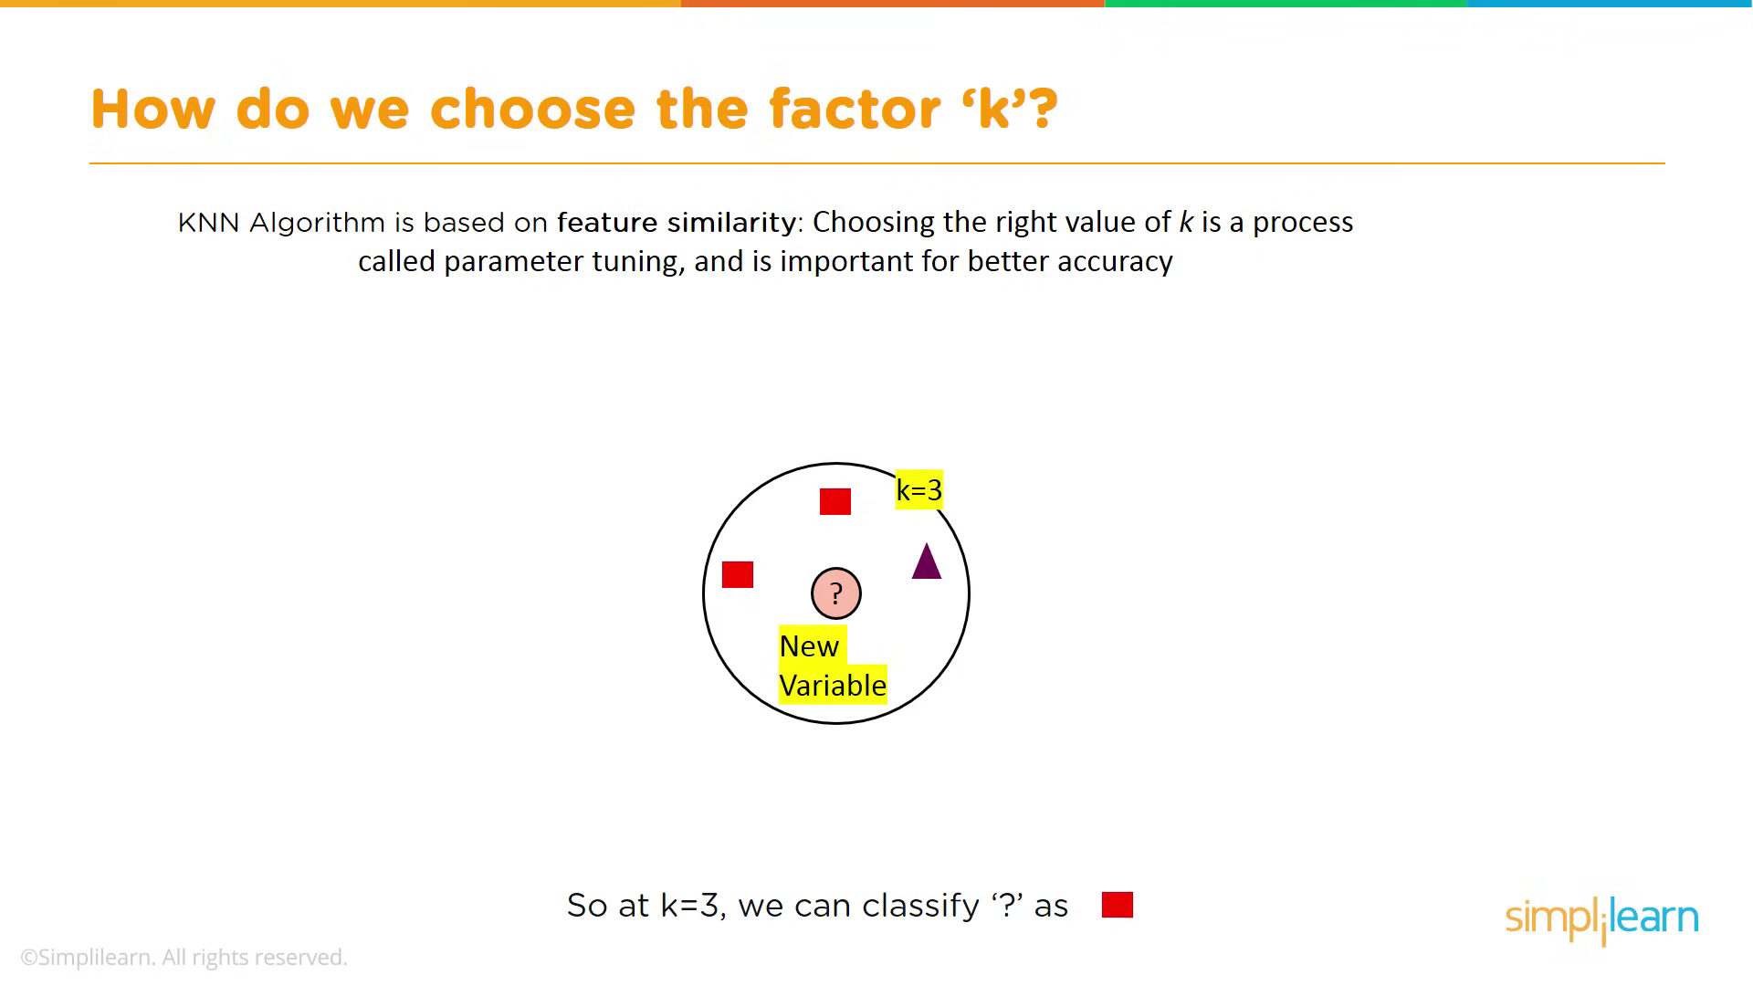

Slide 9
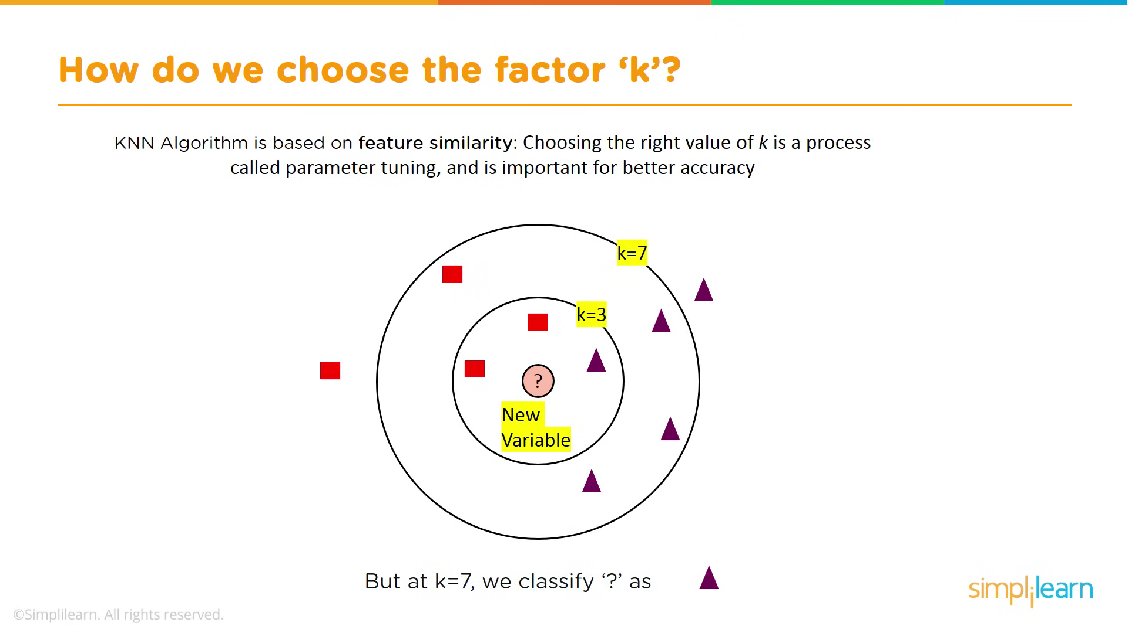

Slide 10
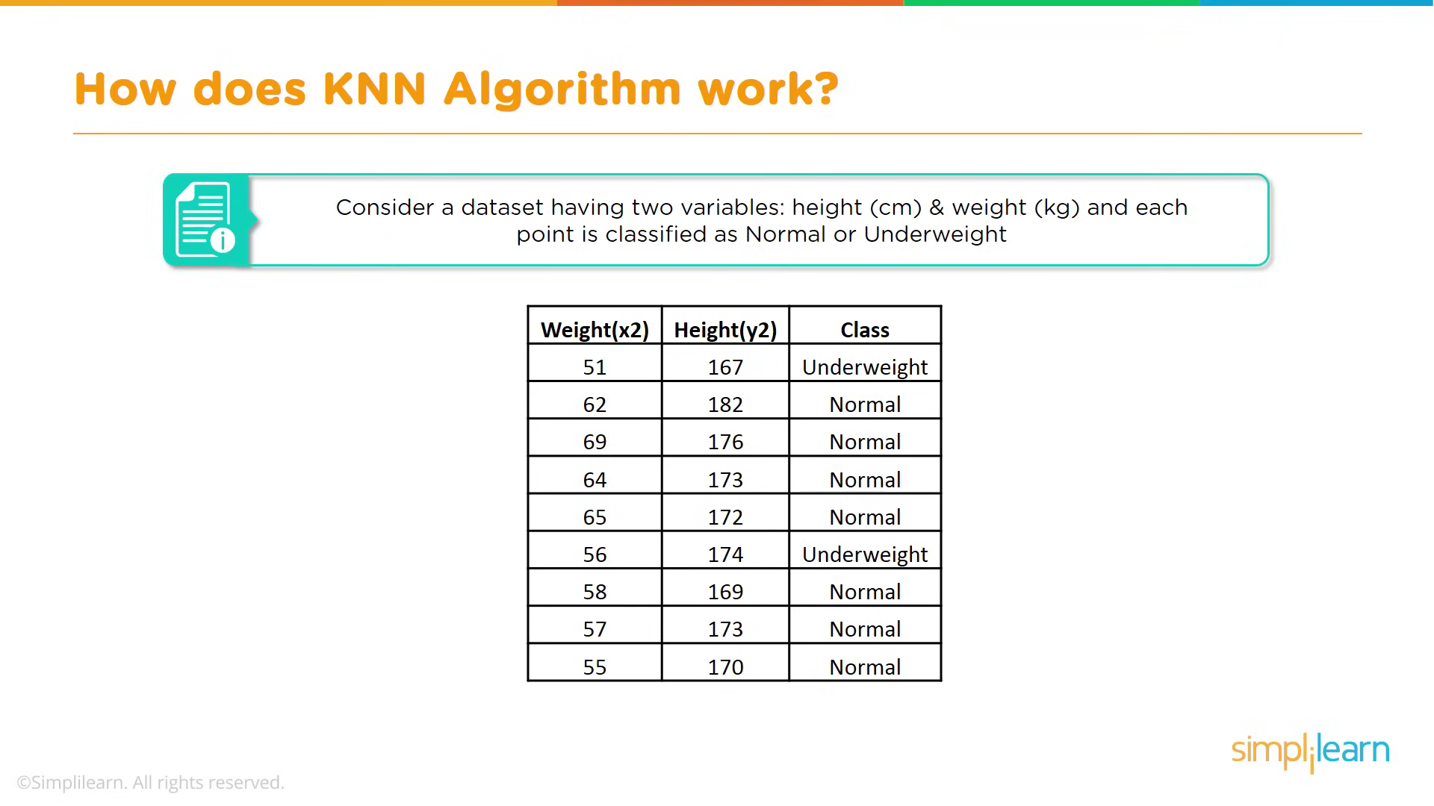

Slide 11
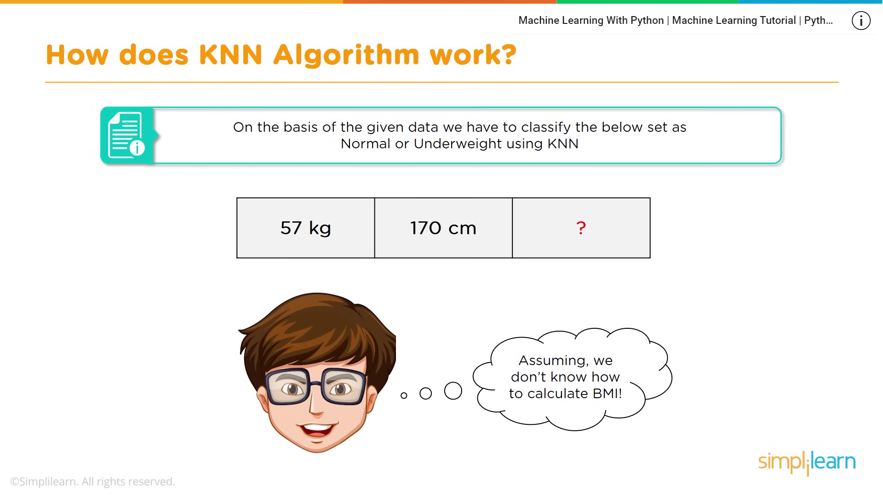

Slide 12
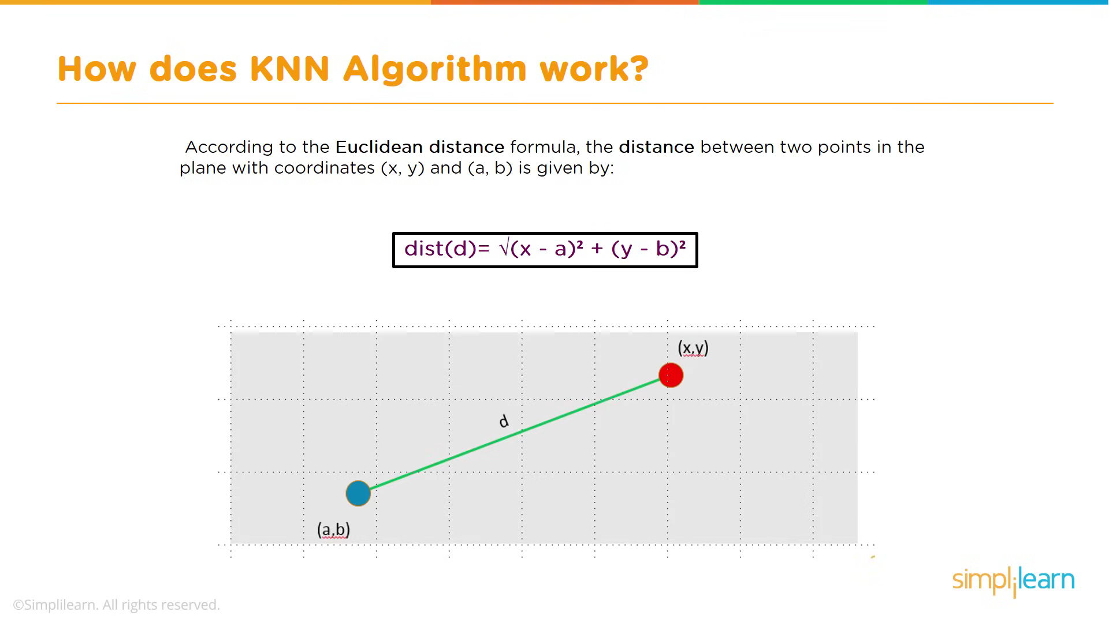

Slide 13
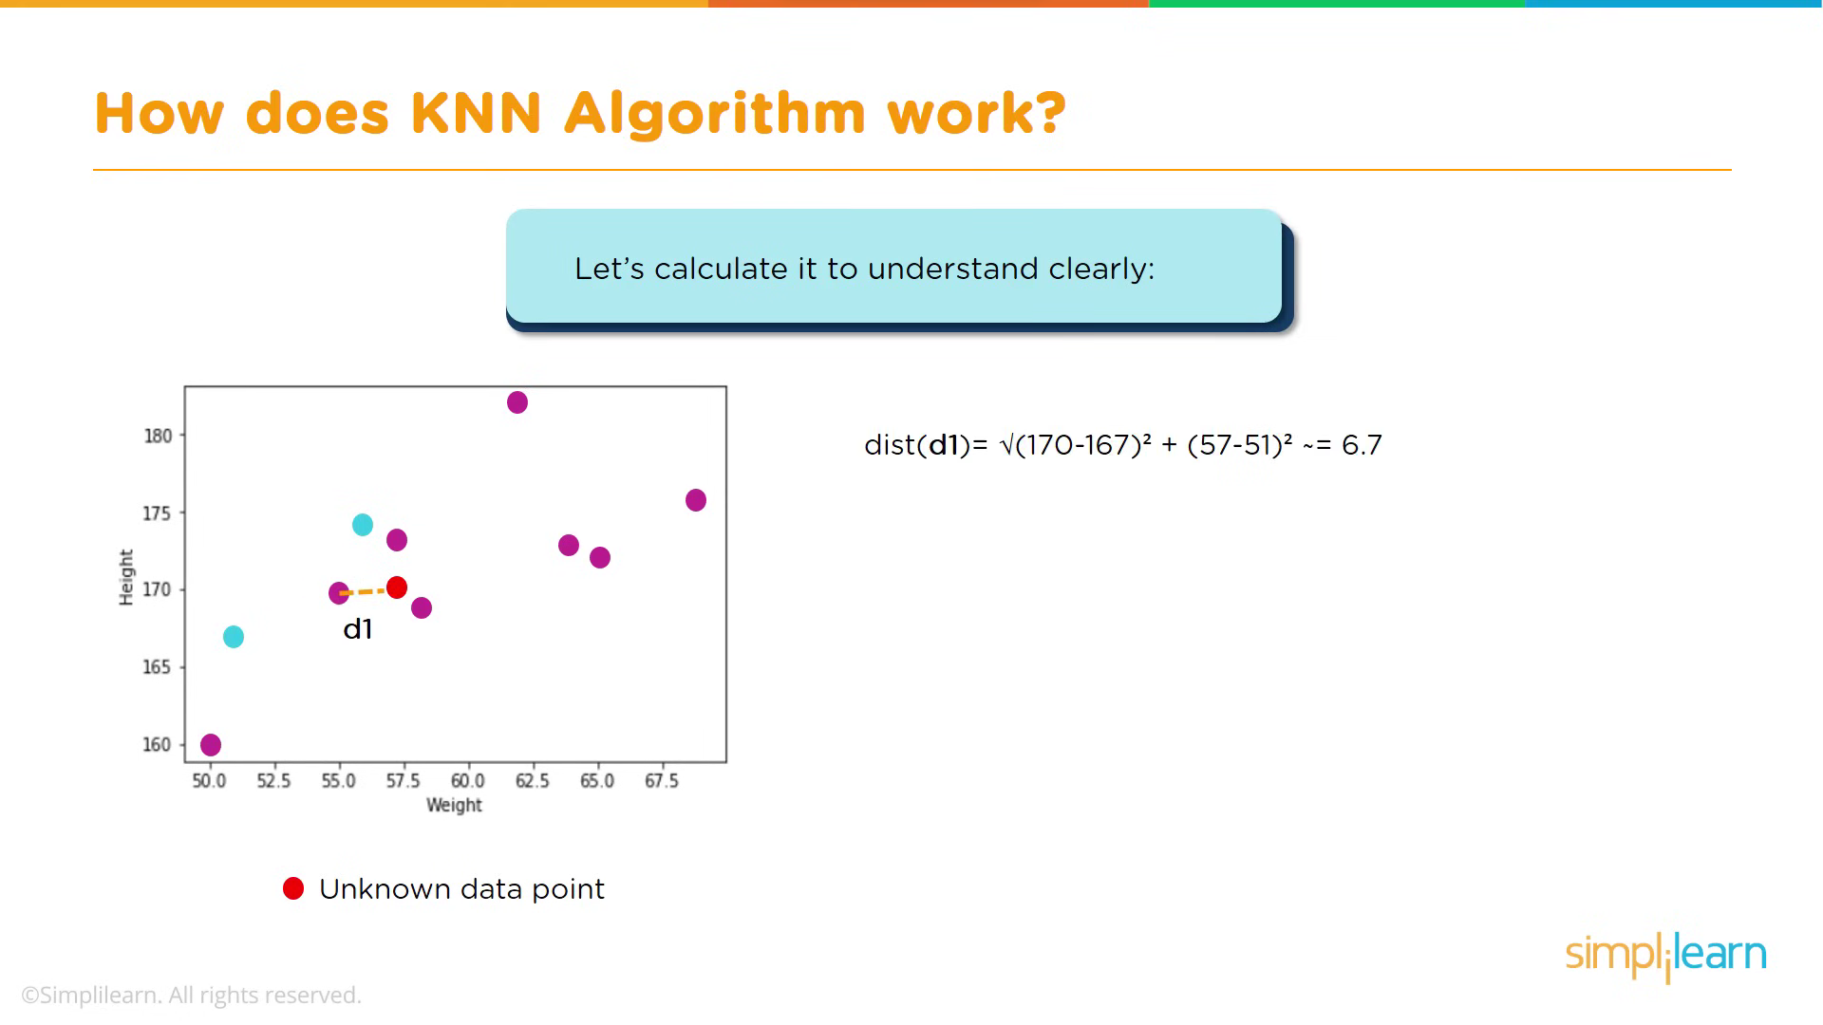

Slide 14
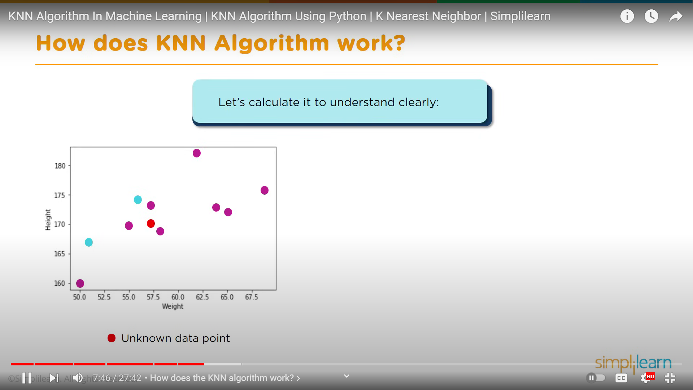

Slide 15
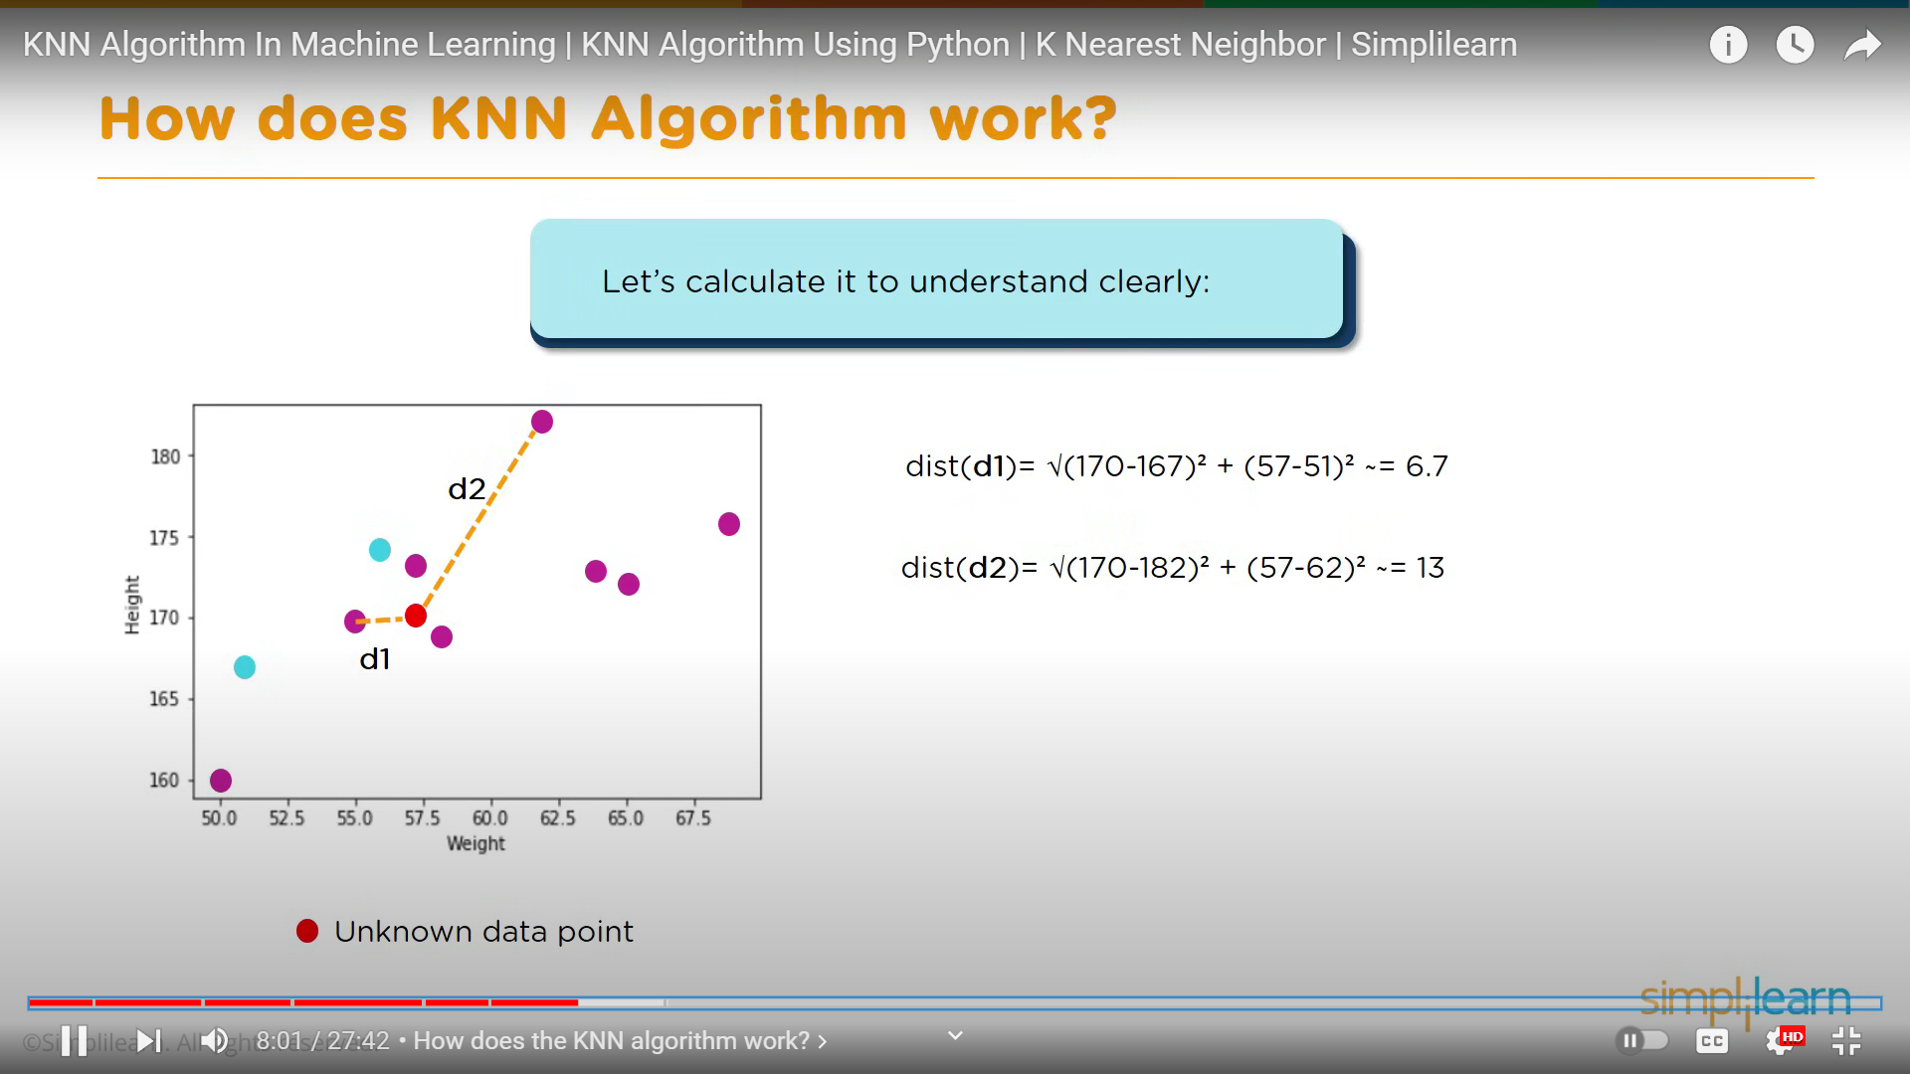

Slide 16
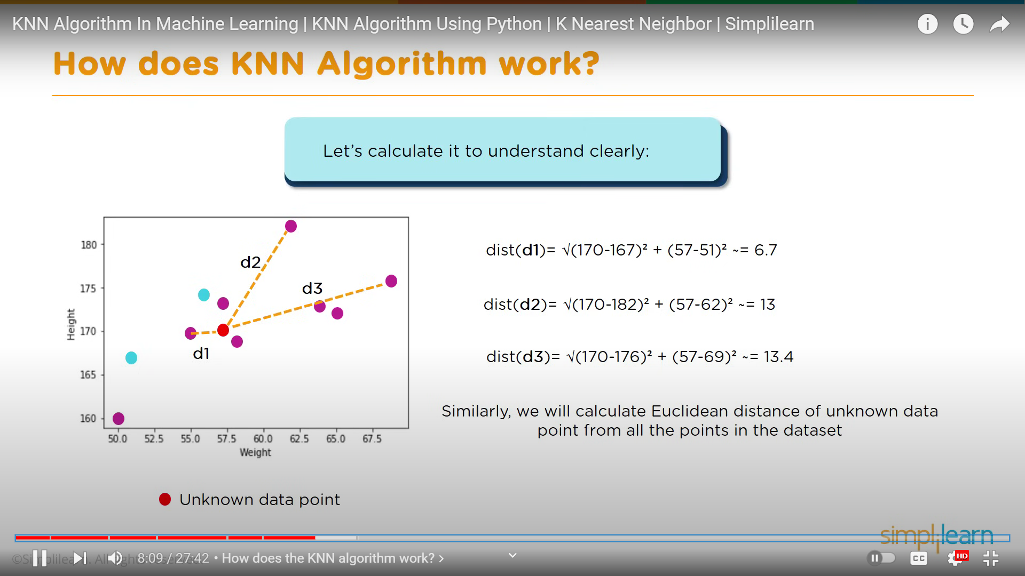

Slide 17
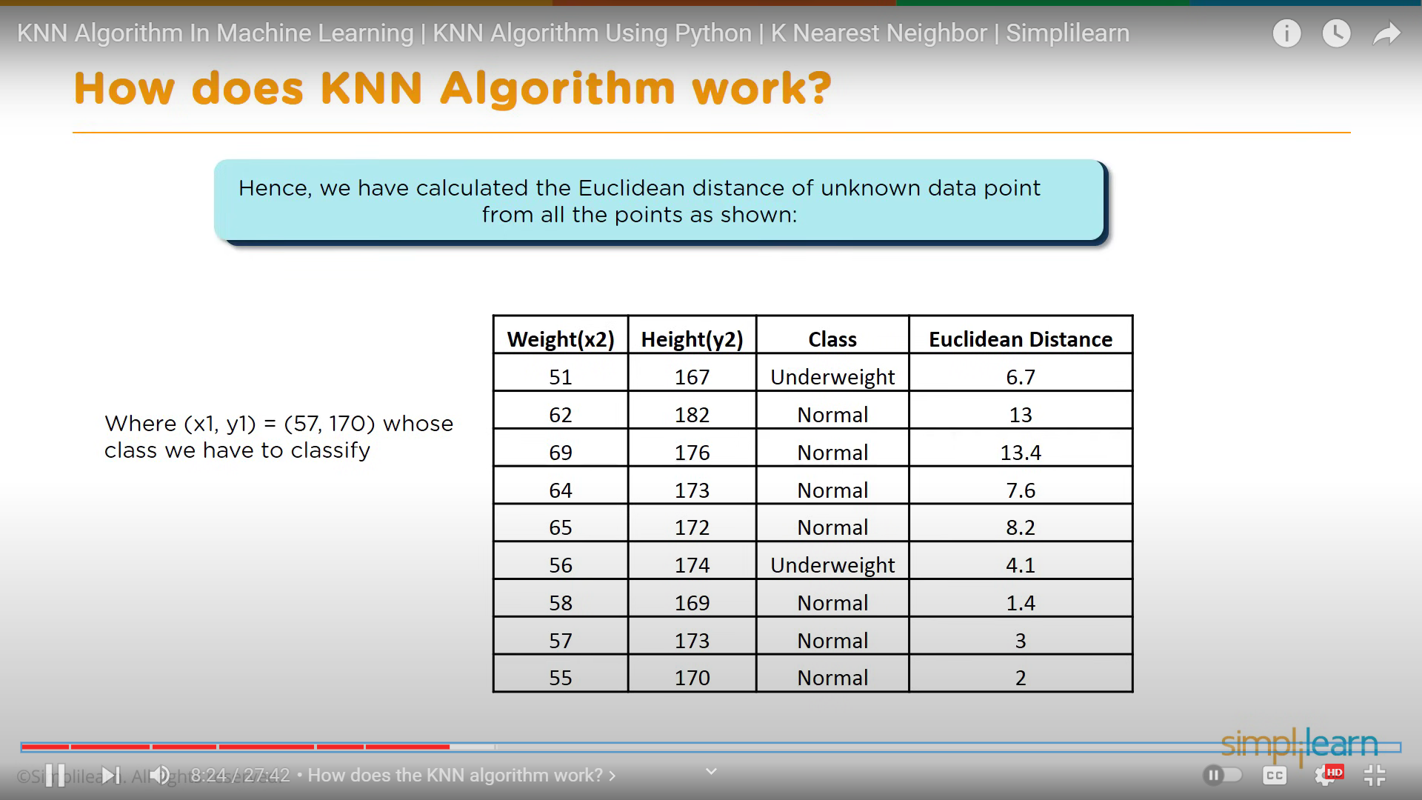

Slide 18
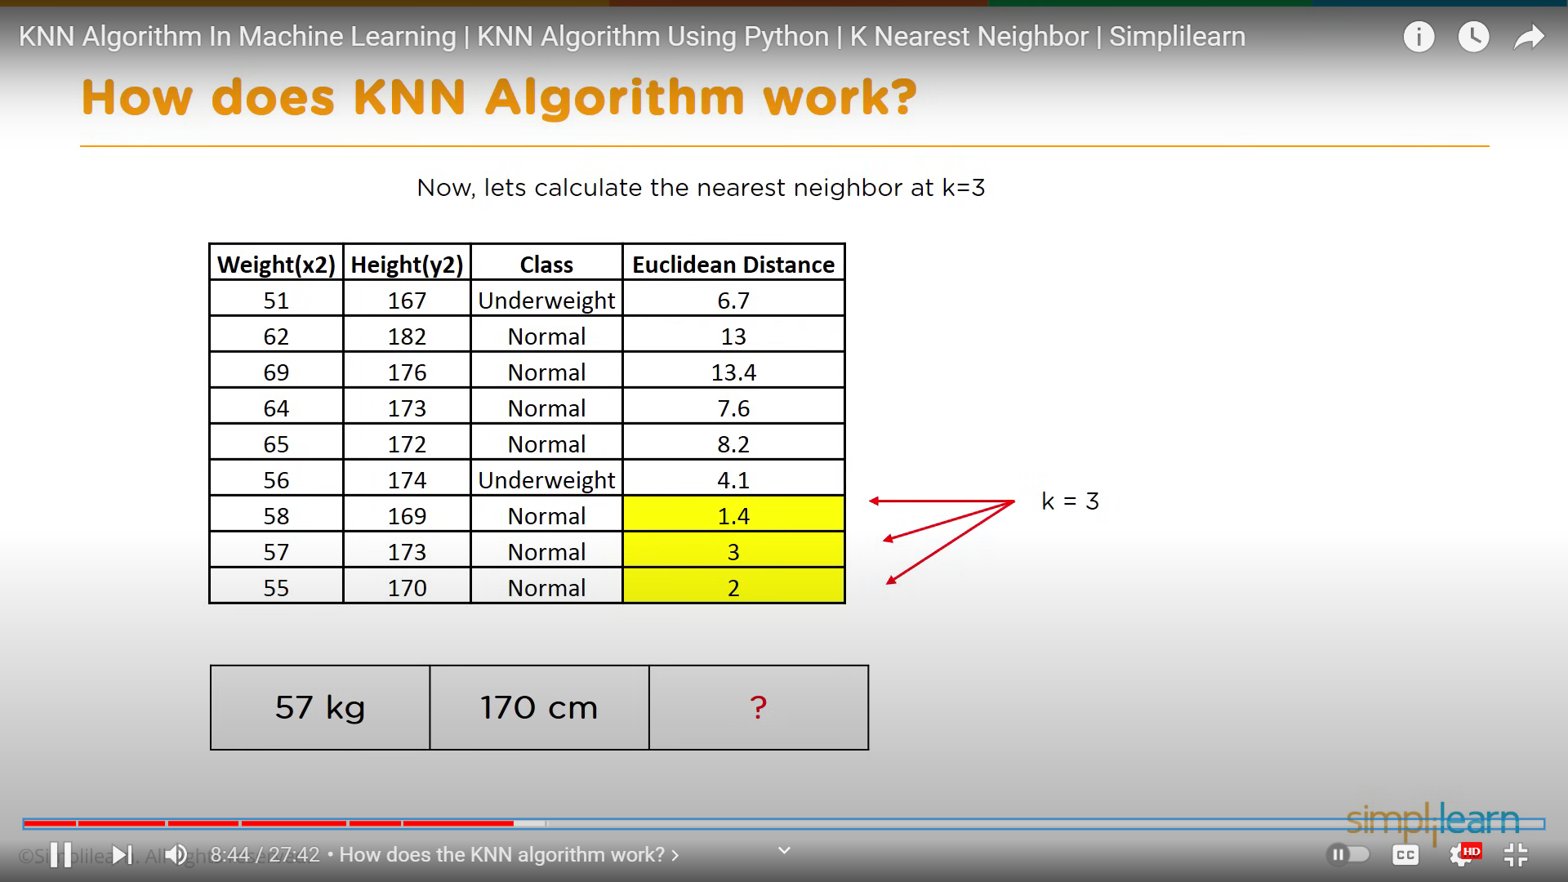

Slide 19
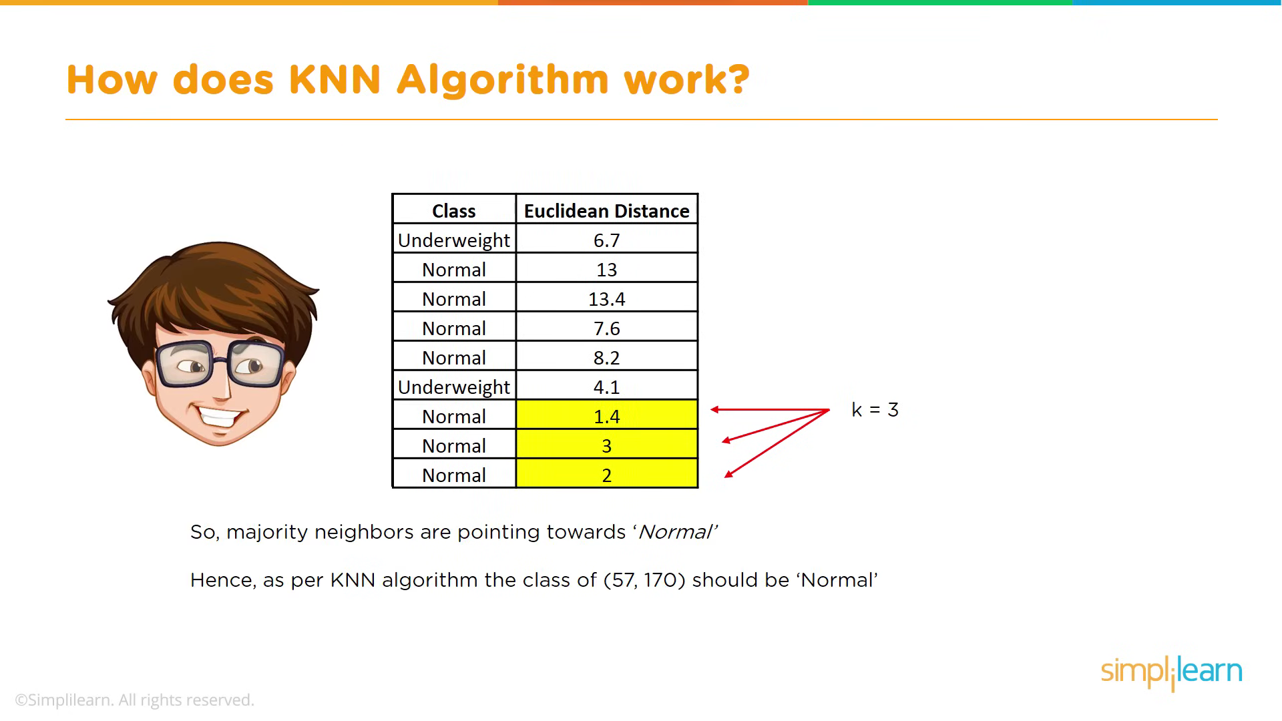

Slide 20
Advantages:
Does not assume a specific functional form.
More flexible for capturing non-linear relationships.
Disadvantages:
Can be complex to understand and interpret.
Works better with a larger number of observations per predictor.
Application:
Linear Regression: Suitable when the relationship is approximately linear.
KNN: Effective when the true relationship is non-linear or unknown.

Slide 21
Decision Tree (DT): It falls under supervised learning. DT builds a tree-like model based on labeled training data to predict the class or value of an unseen input.
KNN: Contrary to the hint, KNN is supervised learning, not unsupervised. It uses labeled data to classify examples. The confusion might arise because K-means (a different algorithm) is indeed unsupervised.

Slide 22
DT: Primarily used for classification tasks. It assigns labels to input data based on features.
KNN: Used for clustering (finding similar examples). It determines neighborhoods based on a distance metric.
DT: Works with both numeric and nominal attributes.
KNN: Requires numeric features due to distance metrics. Varying scales between attributes can impact KNN.

